Slide 1
Optimal Synthesis of Mechanisms For Path Generation Using Fourier Descriptors and Global Search Methods
Problem Statement:
Compute the optimal 4 bar mechanism design to match as closely as possible to a known harmonic curve.

Slide 2
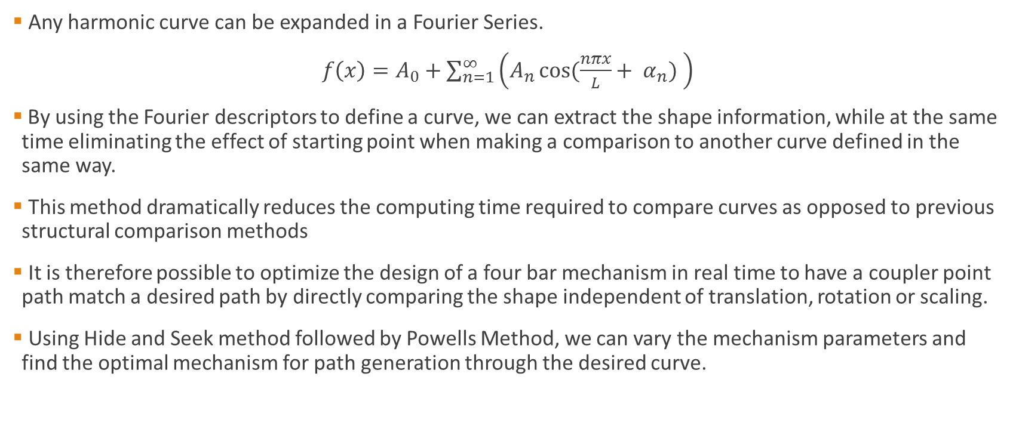
Theory
Any harmonic curve can be expanded in a Fourier Series.
$f\left(x\right)=A_{0}+\sum_{n=1}^{∞}{\left(A_{n}\cos{(\frac{nπx}{L}+ α_{n}) }\right)}$
By using the Fourier descriptors to define a curve, we can extract the shape information, while at the same time eliminating the effect of starting point when making a comparison to another curve defined in the same way.
This method dramatically reduces the computing time required to compare curves as opposed to previous structural comparison methods
It is therefore possible to optimize the design of a four bar mechanism in real time to have a coupler point path match a desired path by directly comparing the shape independent of translation, rotation or scaling.
Using Hide and Seek method followed by Powells Method, we can vary the mechanism parameters and find the optimal mechanism for path generation through the desired curve.

Slide 3
Solutions and Algorithms
We can compare the use of Fourier descriptors for four bar synthesis with the common example of finding the combination of frequencies in a composite sinusoidal wave. The physical points on the curve are held in the same way as frequencies for any real harmonic measurement. Preforming a Fourier Transform extracts the same information regardless of starting point.
In the same way, when we record desired position data for path generation, the Fourier analysis is of the data is naturally independent of starting point, depending only on the shape of the curve. We can find the optimal mechanism by minimizing the Fourier deviation function: Fdev = m*Ampdev x n*Angdev, where Ampdev is the Fourier amplitude deviation and Angdev is the Fourier phase angle deviation.
The most widely know algorithm to compute the Fourier Transform of a set of data is the Fast Fourier Transform(FFT)
The FFT computes the Direct Fourier Transform (DFT) for N points but in a time approximately equal to N/log(N) times faster than DFT computation
A current open source library called FFTW3 as well as QRealFourier exists which is designed to compute the FFT of a set of real or complex data in one to three dimensions. QRealFourier was designed for use with QT.

Slide 4
Example
float samples[SIZE];
float fft[SIZE];
//Creating sample values
for(int i = 0; i < SIZE; ++i)
{
samples[i] = i / float(SIZE);
}
print("Samples before transformation:\n");
print(samples, SIZE);
QFourierTransformer transformer;
transformer.forwardTransform(samples, fft);
transformer.inverseTransform(fft, samples);
print("Samples after transformation and before rescaling:\n");
print(samples, SIZE);
transformer.rescale(samples);
print("Samples after rescaling:\n");
print(samples, SIZE);
return 0;

Slide 5
Class Diagram
HarmonicCurve
GLWidget (I/O)
QObject
Supplemental Classes
Point2D
MechanismScreen
Friend
FFTW
CurveScreen
Sensor
PlanarFourBar
Quaternion
SensorScreen
Friend
RealHarmonicData
DualQuaternion
SensorNetwork
BLE_DistanceSensor
Accelerometer
Friend
Links

